Slide 1
Measures of central tendency
Mean
Mode
median

Slide 2
Measures of central tendency for ungrouped data
We often represent a data set by numerical summary measures, usually called the typical values.
A measure of central tendency gives the center of a histogram or a frequency distribution curve.
We will look at three different measures of central tendency:
Mean
Median, and
Mode
Recall that the data that give information on each member of the population or sample individually are called ungrouped data, whereas grouped data are presented in the form of a frequency distribution table.

Slide 3
mean
The mean, also called the arithmetic mean, is the most frequently used measure of central tendency.
We will use the words mean and average synonymously.
For ungrouped data, the mean is obtained by dividing the sum of all values by the number of values in the data set
Thus mean = (sum of all values ÷ number of values)
The mean calculated for sample data is denoted by x̄ (read as “x bar”), and the mean calculated for population data is denoted by μ (Greek letter mu)

Slide 4
Mean cont--
We know from our previous discussion that the number of values in a data set is denoted by n for a sample and by N for a population.
We also know that a variable is denoted by x, and the sum of all values of x is denoted by Using these notations ∑x , we can write the following formulas for the mean.
Mean for population data: μ = (∑x ÷ N)
mean for sample data: x̄ = (∑x ÷ n)
where ∑x is the sum of all values, N is the population size, n is the sample size, μ is the population mean, and x̄ is the sample mean.

Slide 5
Mean cont--
The following are the ages (in years) of all eight employees of a small company:
53 32 61 27 39 44 49 57
Find the mean age of these employees.

Slide 6
median
The median is the value of the middle term in a data set that has been ranked in increasing or decreasing order.
As is obvious from the definition of the median, it divides a ranked data set into two equal parts.
The calculation of the median consists of the following two steps:
Rank the data set in increasing order.
Find the middle term. The value of this term is the median
Note that if the number of observations in a data set is odd, then the median is given by the value of the middle term in the ranked data.

Slide 7
Median cont--
However, if the number of observations is even, then the median is given by the average of the values of the two middle terms.
The following data give the prices (in millions of shillings) of seven houses selected from all houses sold last month in a city.
3.12 2.57 4.21 2.89 5.26 3.74 4.97
Find the median.

Slide 8
Median cont– (find the median)
The following data table gives the 2008 profits (rounded to billions of dollars) of 12 companies selected from all over the world.
company | 2008 profits (billions of dollars)
Merck & company | 8
IBM | 12
Unilever | 7
Microsoft | 17
Petrobras | 14
Exxon Mobil | 45
Lukoil | 10
AT &T | 13
Nestle’ | 17
Vodafone | 13
Deutsche Bank | 9
China Mobile | 11

Slide 9
mode
Mode is a French word that means fashion—an item that is most popular or common.
In statistics, the mode represents the most common value in a data set.
Or the value that occurs with the highest frequency in a data set.

Slide 10
Mode cont--
The following data give the speeds (in kilometers per hour) of eight cars that were stopped on the Nairobi – Nakuru highway for speeding violations on a 50 Km/h zone.
77 82 74 81 79 84 74 78
Find the mode

Slide 11
Mode cont--
A major shortcoming of the mode is that a data set may have none or may have more than one mode, whereas it will have only one mean and only one median.
For instance, a data set with each value occurring only once has no mode.
A data set with only one value occurring with the highest frequency has only one mode.
Such a data set in this case is called unimodal.

Slide 12
Mode cont--
A data set with two values that occur with the same (highest) frequency has two modes.
The distribution, in this case, is said to be bimodal.
If more than two values in a data set occur with the same (highest) frequency, then the data set contains more than two modes and it is said to be multimodal.

Slide 13
Which one is the best measure of central tendency?
It cannot be said for sure which of the three measures of central tendency is a better measure overall.
Each of them may be better under different situations.
Probably the mean is the most-used measure of central tendency, followed by the median.
The mean has the advantage that its calculation includes each value of the data set.
The median is a better measure when a data set includes outliers.
The mode is simple to locate, but it is not of much use in practical applications.

Slide 14
Relationships Among the Mean, Median, and Mode
As discussed earlier two of the many shapes that a histogram or a frequency distribution curve can assume are symmetric and skewed. We will now describe the relationships among the mean, median, and mode for three such histograms and frequency distribution curves.
Knowing the values of the mean, median, and mode can give us some idea about the shape of a frequency distribution curve.

Slide 15
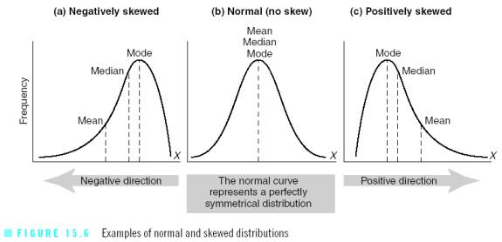
Relationships Among the Mean, Median, and Mode cont--

